Slide 1
Deep Learning based Automated Attendance System
B. Tech Capstone Project
Under the guidance of Dr. Vaidehi Vijayakumar

Slide 2
Team Members
Adithya S. 14BCE1086
C. Anirudh Bhardwaj 14BCE1130
Jugat Singh Lamba 14BCE1150

Slide 3
Problem Statement
Attendance is an important criterion in Education, as it enforces discipline and has been observed to yield better performance from students. In an average class of 60 students, a teacher spends nearly 10 minutes in just identifying the students present in the class to provide attendance. This leads to chaos, and can also result in a phenomenon called “proxy attendance” wherein a random person trying to put attendance for a missing pupil. To combat this problem, we try to come up with an innovative solution using Deep Learning Principles to automated the process of attendance, while at the same time minimizing the occurrences of such false positives

Slide 4
Approach
We use a multi-tiered approach to face recognition in a group setting
1. The photo is taken of a group
2. The photo is passed through a Face Detection neural networks so that bounding boxes on the faces are made
3. The photos are cropped on the basis of bounding boxes
4. The cropped photos are now processed using a Face Recognition Neural Network to identify the person in the photo
5. The results obtained in each cropped photo are displayed

Slide 5
Abstract
A significant portion of the time allocated to a faculty for teaching purposes is consumed on the task of taking attendance of the students presently attending a class. This is an issue because it takes the valuable time of teachers which could be spent on more productive tasks such as teaching and interacting with students and also leads to an increase in chaos and a loss of decorum in the classroom. Further, the presence of proxy attendance also plagues the existing method of manual attendance keeping. To counter these issues, an automated attendance system is proposed; which keeps track of students attending a particular class with the help of a continuous stream of pictures captured from a video streaming device located inside a classroom connected to the remote server with the help of Information and Communication Technology (ICT). The proposed solution would reduce the amount of time spent by the faculty on taking attendance, and would also lead to a reduction in chaos inside a classroom.

Slide 6
Cont.
The proposed method, termed as DPAAS (short for Deep Learning Assisted Attendance System), uses Deep Learning principles to identify the individuals present in a classroom environment. There are certain issues such as the need of multi-class identification for multiple individuals in any given classroom, as well as factors such as occlusion, differing light scenarios etc. that need to be taken into consideration while implementing DPAAS. Multi class identification in the context of Face Recognition has been a heavily researched topic, and the current state of art systems for object detection and localization include deep learning architectures such as R-CNN[1], Fast and Faster R-CNN[2,3], YOLO[4], YOLO(v2), and Overfeat[5]. This work compares the results of the state of art implementations, and uses the best fit architecture which provides the lowest false positive and false negative rate on evaluation. The chosen architecture is fit into the end to end solution proposed, which makes use of the ICT paradigm to connect a live stream of pictures obtained from a camera located inside a classroom to a remote server, via a thin client, where the majority of the necessary computing work is performed. The queries to the remote servers are in the form of images, which are obtained from the live camera. The images are processed and fed into a deep neural network which identifies the individuals present inside the frame, the details of which are returned to the thin client. The procured result is of the form of a list of students present, with their details such as registration number, student name and class room. This result can be automatically synced to the attendance system to provide an automatic updation of attendance without any human intervention.

Slide 7
Architecture
Group Photo
Bounding boxes through face detection
Face Recognition from pictures cropped using bounding boxes

Slide 8
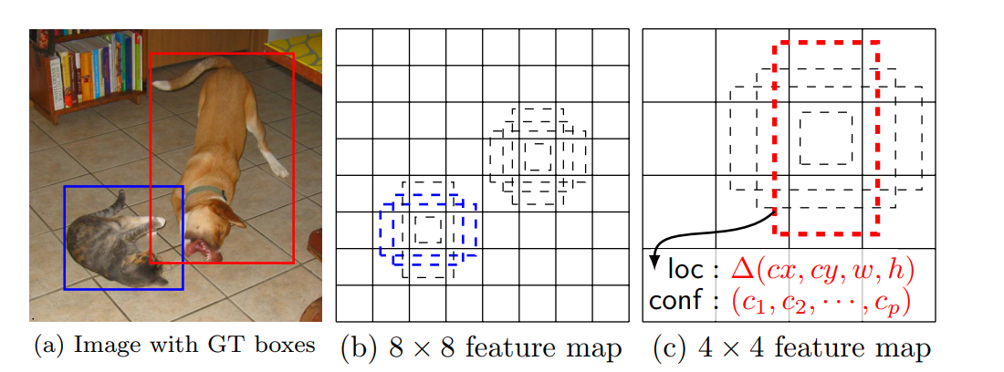
Face Detection
There are multiple algorithms such as YOLO, Overfeat, R-CNN etc which allow for object detection in the images.
The fastest algorithm amongst them is the SSD (single shot multi-box) network
SSD algorithm works by calculating a category score and offsets for fixed set of bounding boxes using small convolution filters applied to feature maps

Slide 9
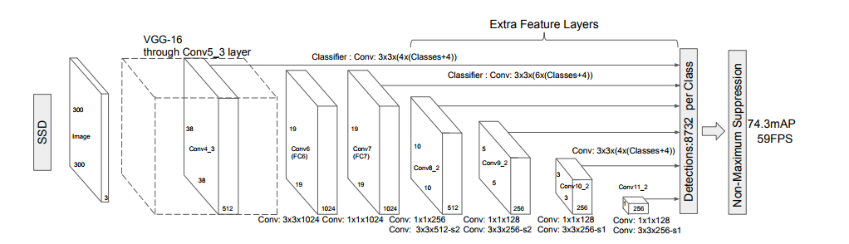
SSD cont.

Slide 10
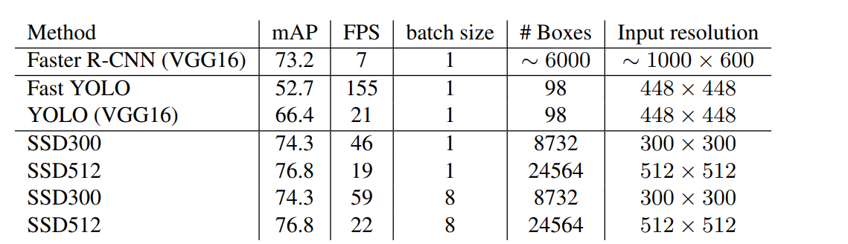
SSD Con.
The SSD algorithm achieves state of art accuracy, while at the same time having a lower time to execution as compared to other algorithms such as YOLO, Overfeat, R-CNN etc.

Slide 11
SSD
Contrary to the original implementation, we have taken RESNE T as the base networks because the network is deeper than VGG 16, at the same time has lesser size on disk due to the presence of only one max pooling layer
For more information on SSD, kindly read the original paper on ArXiv: https://arxiv.org/pdf/1512.02325.pdf

Slide 12
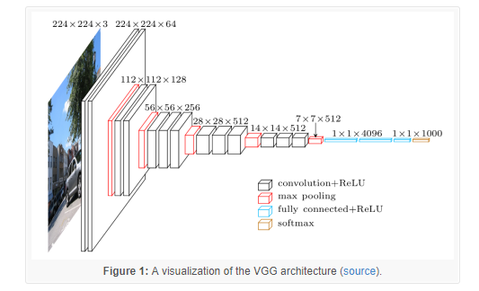
Face Detection
There are multiple complex neural network architectures which can result in slow and overfit solutions
We use a VGG 16 neural network architecture to correctly identify a face in the result

Slide 13
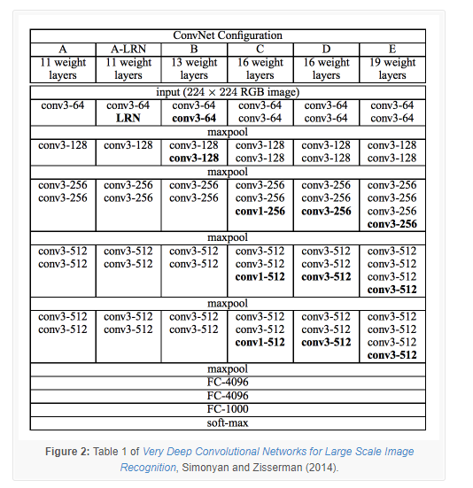
VGG 16 cont.
We use option D (VGG 16 Layers)
This is done because this model gives us sufficient accuracy while at the same time having a lower computation time at inference

Slide 14
Problems to be encountered
Orientation of face
Illumination
Occlusion
Slower Inference at run time
SSD has difficulty in dealing with small bounding boxes

Slide 15
Solving the problems
Slower Inference Problem: SSD and VGG 16 allow for face detection in a group setting in near real time
SSD has difficulty in identifying smaller bounding boxes: use data augmentation techniques such as passing cropped photos into SSD during training to ensure that it has ability to detect small objects too
Orientation: Two methods: 1. Pose Orientation, 2. Multiple Camera Setup
Occlusion: Multiple Cameras
Illumination: Standard Illumination conditions due to Indoor nature of work

Slide 16
Datasets
Face Detection: WIDER Dataset
Face Recognition: LFW Dataset
Links are given in the GitHub URL: https://github.com/adithya-subramanian/Deep-Learning-based-Automated-Attendance-System

Slide 17
Framework
Tensorflow (with GPU)
Python (version 2.X)

